Slide 1
Sanctification – Part 1
John Edmiston

Slide 2
Salvation, Justification, Glorification and Sanctification
Justification is “being made right with God” and is “just as if I’d never sinned”. This happens instantly when you are born-again and is a once-off event and is when you receive your new nature. It is a free grace gift.
Sanctification is the Christian being made more and more holy and like Jesus and is a process with some “big moments” in it and is the working out of the new nature in a life of faith, love, spiritual abundance and fruitfulness.
Glorification is when you receive your resurrection body and also your eternal rewards for obedient, fruitful service to God.
Salvation is a very wide and extensive term for “all of the above plus healing, deliverance and rescue from life situations”. You work out your salvation but not your justification.

Slide 3
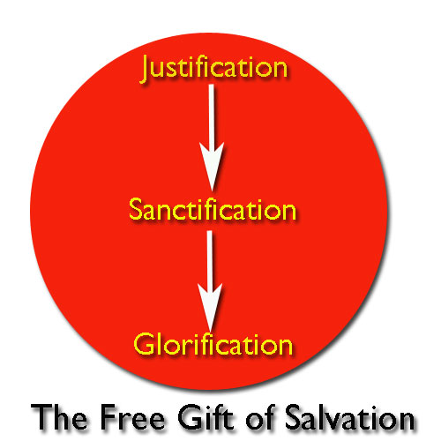

Slide 4
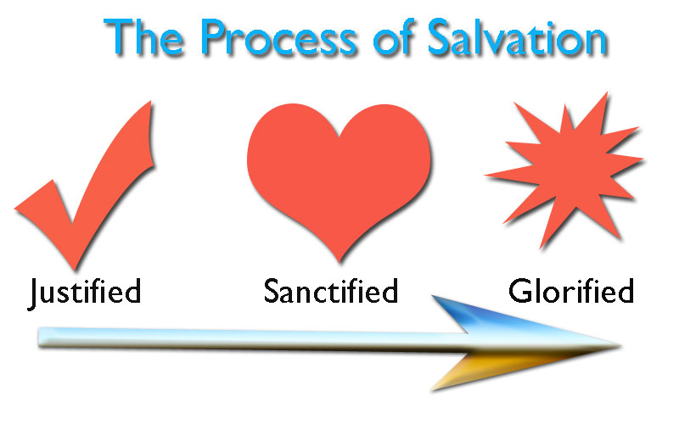

Slide 5
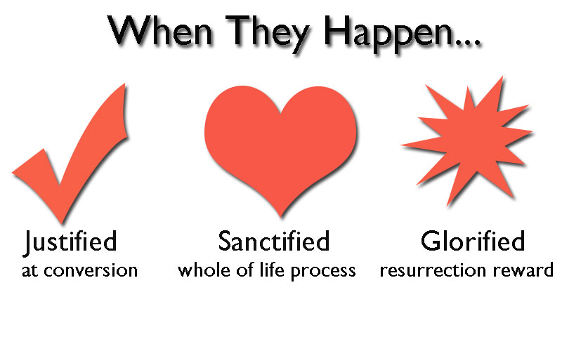

Slide 6
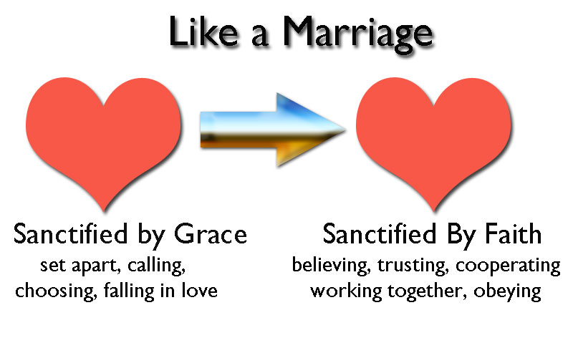

Slide 7
The Place of Faith
Becoming holy and growing in Christ Jesus is a work of faith.
You believe in God, you receive from God, and you then act in faith on what you have received from God.
For instance if you receive a calling and a gift of teaching you then have to work out that gift of teaching, in faith, that it is a holy calling that sets you apart for God.
Similarly we are all called to be loving, so we believe that God is love, we then receive love from God, than act lovingly towards others.

Slide 8
It Is Definitely NOT About “Being Good..”
The Pharisees were always worried about being good and right and keeping various laws and human rules and Jesus called them “sons of the Devil…”
If you are “right” then someone else is “wrong” and this rapidly breeds legalism and contention. After a while only you are right, everyone else is wrong, and this is NOT the Christian spiritual position of love and grace. (You end up way off-course as soon as you adopt right/wrong thinking and side with the “Accuser”.)
The Fundamentalist idea about “being right” is dangerous whether it is Christian, Muslim or Hindu fundamentalism or even politically correct idealistic fundamentalism.
“Being good” is the law and the letter and just brings death and destruction and alienation from yourself, from others and from God.

Slide 9
It’s NOT A Big Box You Try To Live In
Sometimes we “try not to be unspiritual” as if “spiritual” was a box with boundaries and anything outside that box was “unspiritual”
“Spiritual” has nothing to do with wine, beer, tattoos, tastes in music, how long your skirt is, what degrees you do or don’t have, what kind of car you drive, or what bible translation you use!
“Spiritual” also has nothing much to do with how often you go to church or how often you attend religious ceremonies.
Spiritual = living in the Spirit = living in love, mercy grace…
DEMOLISH YOUR “BOX” RIGHT NOW!!

Slide 10
What Then Is Good?
Micah 6:6-8 (HCSB)
What should I bring before the LORD when I come to bow before God on high? Should I come before Him with burnt offerings, with year-old calves?
Would the LORD be pleased with thousands of rams or with ten thousand streams of oil? Should I give my firstborn for my transgression, the child of my body for my own sin?
Mankind, He has told you what is good and what it is the LORD requires of you: to act justly, to love faithfulness, and to walk humbly with your God.

Slide 11
It Is NOT About Culture or Class..
You are not “holier” if you are highly successful, all your teeth are pearly white and straight, your drive a Mercedes, and all your kids play the violin and go to Ivy League colleges…
Neither are you more spiritual if you are a skinny starving missionary living in a brown paper bag on a barbed wire fence among cannibals in Papua New Guinea…
Chinese Christians are not necessarily more spiritual than American Christians or Jewish Christians or Mexican Christians or Filipino Christians – race and culture are not even considered in the gospel…

Slide 12
It Has Almost Nothing To Do With Doctrine
There are some essential doctrines but they are few and far between and mainly concern the person and work of Jesus Christ.
The Pharisees memorized the whole Old Testament but totally missed the point of the life and ministry of Jesus the Messiah.
Off-track fundamentalists e.g. Westboro Baptist Church put “knowing the Bible” way ahead of love, mercy, humility and justice. There are many who “know everything” about doctrine but nothing about love, joy or peace!

Slide 13
It’s Not About Emotions…
People can have amazing emotional experiences of God and end up going from conference to conference for “another dose of whatever that was”. They are immature, and not sanctified!
Some people are naturally positive and happy and they are not “holier” than others’ some are naturally introspective and they are not necessarily “deeper spiritually” than others.
A few centuries ago glum, depressive, gloomy people who “hated the world” were considered more spiritual, but that was also a false stereotype.
Fanatical zeal does not make you holy either and neither does travelling over land and sea to make a single convert…

Slide 14
It’s Not About Success and Numbers
God isn’t that worried about what numbers you achieve in ministry. Some with “huge ministries” will end up in Hell! (See Matthew 7).
Isaiah and Jeremiah seem to have had “negative numbers” in their ministry(everyone fell away or were judged etc). Only two of Moses original disciples made it into Canaan.
Beware when everyone speaks well of you…!
Don’t sell out the gospel just to be popular today!
Jesus made it DIFFICULT to follow Him!

Slide 15
It’s Not About Having Status In Church
Pastors, missionaries, bishops and popes are not necessarily any more sanctified than plumbers and fishermen!
There are plenty of unsaved clergy and gloriously saved laity!
If your Christian life is all about your “position” in some church hierarchy then you have totally missed the point of the gospel!
We are called to be servants and not to lord it over others!

Slide 16
It Is About Spiritual Fruitfulness!
Sanctification is ALL about having a new nature, which is Christ in you, producing spiritual fruit through you, to the glory of God.
Which is more important: Being able to expound on the differences between the North Galatian theory and the South Galatian Theory or being able to know, experience, enjoy and pass on to other the incredible joy of the Lord in your life so that people can see, taste and grab hold of the spiritual fruit growing in you through Christ?
Sanctification is about VERIFIABLE SPIRITUAL FRUIT: Your life should “taste” of love, joy, peace, patience, goodness, kindness, gentleness, faith, faithfulness, self-control, meekness, wisdom, righteousness, forbearance, truthfulness, integrity, graciousness, friendship, brotherly love, generosity , hospitality, courage, encouragement etc.
It is the SAVOR OF CHRIST”’S LIFE – reeking with eternity!

Slide 17
Who Will You Be When You Get There?
Sanctification is about WHO you will be, as a son of God, in the image of Jesus Christ, when you arrive in Heaven!
Are you like Jesus or not like Jesus?
Is there any resemblance between your inner nature and the nature of Jesus Christ?
Does your attitude to weak, broken and sinful people resemble that of Jesus?
Are you as concerned with healing, restoring and resurrecting people as Jesus was?
Are you as willing to “not write off” people as Jesus was?
Are you as determined to live in love and the Father’s will?

Slide 18
There Is No Spiritual Ladder!
Sanctification is NOT climbing some great long spiritual ladder with prostitutes and drug addicts on the bottom and Billy Graham at the top…
Jesus was kinder to the “bottom-of-the-ladder” Samaritan woman in John 4 than to “top-of-the-ladder” Nicodemus in John 3!
Jesus seemed to avoid many of the top-of-the ladder people such as Pharisees, Scribes, High Priests, Herod, etc.
On the other hand Jesus actively sought out the supposed “bottom-of-the ladder” people e.g. Roman soldiers, lepers, demoniacs, prostitutes , sinners, tax-gatherers etc.
There is no “ladder” of spiritual achievement there is ONLY faith in God and openness to Him and all that He has for us!

Slide 19
Sanctification Is Becoming Loving
We say that
which is in our heart, in our inner being.
We then do what we think, say and believe to be true.
Our thoughts, beliefs, words and actions then cause us to become a certain type of person.
Great Commandments
1. Love God
2. Love Your Neighbor
3. Love One Another As I Have Loved You (Christian Community)

Slide 20
The Choice: Loving Or Selfish?
Matthew 25, Luke 12:16-20, Luke 16, and many of the parables make a distinction between loving people and selfish people.
Selfish people use their good fortune to “build bigger barns” instead of blessing others and they lose their souls. They lack compassion for Lazarus the beggar at the gate or for the hungry saints. Selfish people end up being punished in everlasting fire.
Loving people are faithful to God’s commandments. They receive eternal life (the life of love) and an abundance which is pressed down and flowing over.
Every day we are faced with the choice to be loving or to be selfish, to obey the three Great Commandments (love God, neighbor, one another) or to disobey them and the outcome has a huge bearing on our sanctification and our reward.

Slide 21
Flesh Vs. Spirit
Galatians 5:16-26 (HCSB) I say then, walk by the Spirit and you will not carry out the desire of the flesh. For the flesh desires what is against the Spirit, and the Spirit desires what is against the flesh; these are opposed to each other, so that you don’t do what you want. But if you are led by the Spirit, you are not under the law. Now the works of the flesh are obvious: sexual immorality, moral impurity, promiscuity, idolatry, sorcery, hatreds, strife, jealousy, outbursts of anger, selfish ambitions, dissensions, factions, envy, drunkenness, carousing, and anything similar. I tell you about these things in advance — as I told you before — that those who practice such things will not inherit the kingdom of God. But the fruit of the Spirit is love, joy, peace, patience, kindness, goodness, faith, gentleness, self-control. Against such things there is no law. Now those who belong to Christ Jesus have crucified the flesh with its passions and desires. Since we live by the Spirit, we must also follow the Spirit. We must not become conceited, provoking one another, envying one another.

Slide 22
Egotistical Nature vs. Loving Nature
The flesh is selfish, egotistical and manipulative and has the outward self at the center of the universe: squabbling, contentiousness, love of preeminence, self-importance, strife, murder, self-centered sexual relationships, using others, manipulation via witchcraft, callousness towards others and their feelings.
The Spirit is loving, kind, gracious, full of faith, mercy and good fruits and is the essence of God, the fullness of God, Christ the image of God, dwelling in us as Spirit (see Ephesians 3:14-21). The impulses of the Spirit are holy, pure, good, loving and kind, and are unconcerned with the egotistical self-life in this world.

Slide 23
The Mind & The Spirit
Romans 8:3-9 (HCSB) What the law could not do since it was limited by the flesh, God did. He condemned sin in the flesh by sending His own Son in flesh like ours under sin’s domain, and as a sin offering, in order that the law’s requirement would be accomplished in us who do not walk according to the flesh but according to the Spirit. For those who live according to the flesh think about the things of the flesh, but those who live according to the Spirit, about the things of the Spirit. For the mind-set of the flesh is death, but the mind-set of the Spirit is life and peace. For the mind-set of the flesh is hostile to God because it does not submit itself to God’s law, for it is unable to do so. Those who are in the flesh cannot please God. You, however, are not in the flesh, but in the Spirit, since the Spirit of God lives in you. But if anyone does not have the Spirit of Christ, he does not belong to Him.

Slide 24
Walking In The Spirit
If our minds are set on carnal, earthly, selfish things then the result will be that we will be overwhelmed by the incessant demands of our ego and by external events and by lusts and impulses which will destroy us and lead to death, anxiety, fear and turmoil and to a bewilderingly bad Christian life.
If our minds are set on the things of the Spirit, we will walk in the Spirit, we will move out from the domination of our ego and our sinful nature, and we will have life and peace. The mind set on the Spirit brings integrity, healing and wholeness to us and makes us come alive with eternal life!

Slide 25
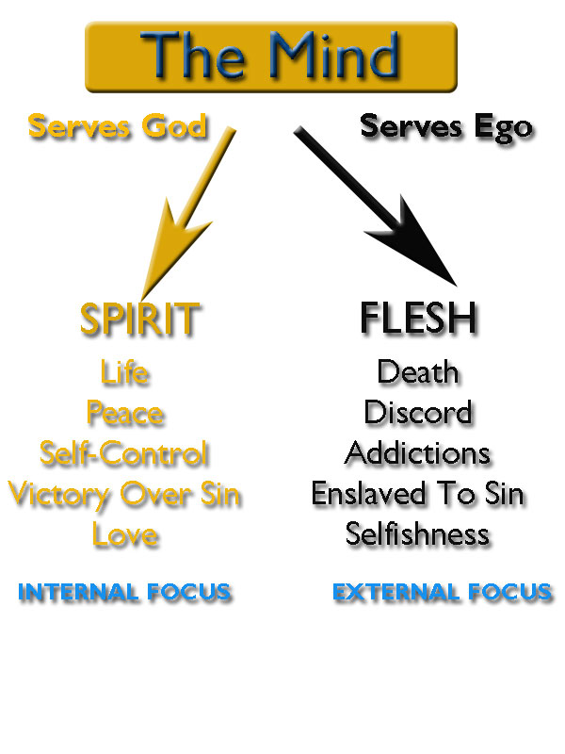

Slide 26
Spiritual Life vs. Legalism
The Spirit
The Letter / The Law
Gives life
Defeat sin in the members
No condemnation
Change us powerfully
Sets us free to be sons of God rejoicing in Abba Father
The free gift of Christ’s righteousness, unearned
Gives us grace so we can be transparently ourselves
Brings death
Arouses sin in the members
Brings condemnation
Has no power to change us
Forces us to become slaves living in fear
All about achieving our own righteousness
Leads to hypocrisy

Slide 27
Voices In Our Head
Jesus Christ
The “Ought To Monster”
My grace is sufficient for you for power is perfected in weakness!
Justified! No condemnation
Sabbaths, rest, joy, peace
Already approved and loved, God’s love is poured out on you
You have a future and a hope
Trust God in faith
Ought to, should, must, have to, gotta, right now…
You will never be good enough
Hurry up on everything
You are not pleasing God, you are a spiritual failure
You are a hopeless reject
Obey more rules

Slide 28
Sanctification and Freedom
2 Corinthians 3:6-18 (HCSB)
He has made us competent to be ministers of a new covenant, not of the letter, but of the Spirit. For the letter kills, but the Spirit produces life. Now if the ministry of death, chiseled in letters on stones, came with glory, so that the Israelites were not able to look directly at Moses’ face because of the glory from his face — a fading glory — how will the ministry of the Spirit not be more glorious?...... We are not like Moses, who used to put a veil over his face so that the Israelites could not stare at the end of what was fading away, but their minds were closed. For to this day, at the reading of the old covenant, the same veil remains; it is not lifted, because it is set aside only in Christ. Even to this day, whenever Moses is read, a veil lies over their hearts, but whenever a person turns to the Lord, the veil is removed. Now the Lord is the Spirit, and where the Spirit of the Lord is, there is freedom. We all, with unveiled faces, are looking as in a mirror at the glory of the Lord and are being transformed into the same image from glory to glory; this is from the Lord who is the Spirit.

